Slide 1
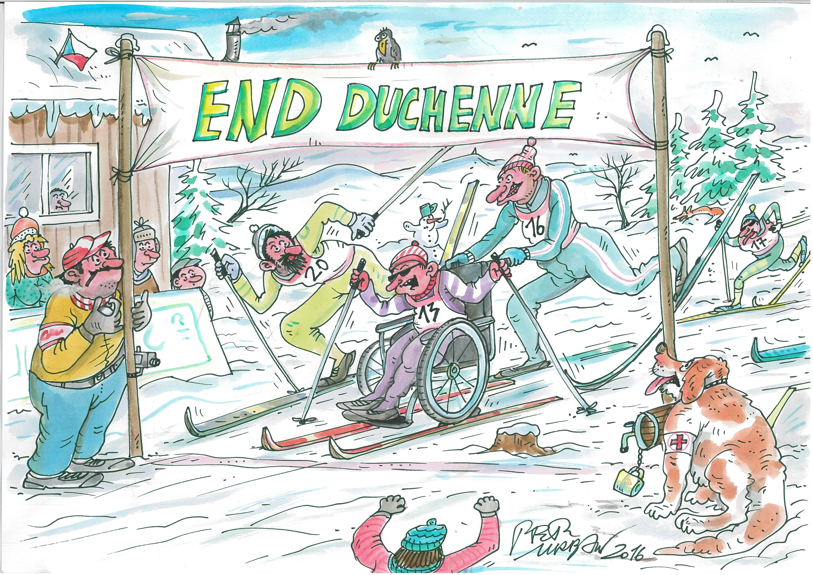


Slide 2

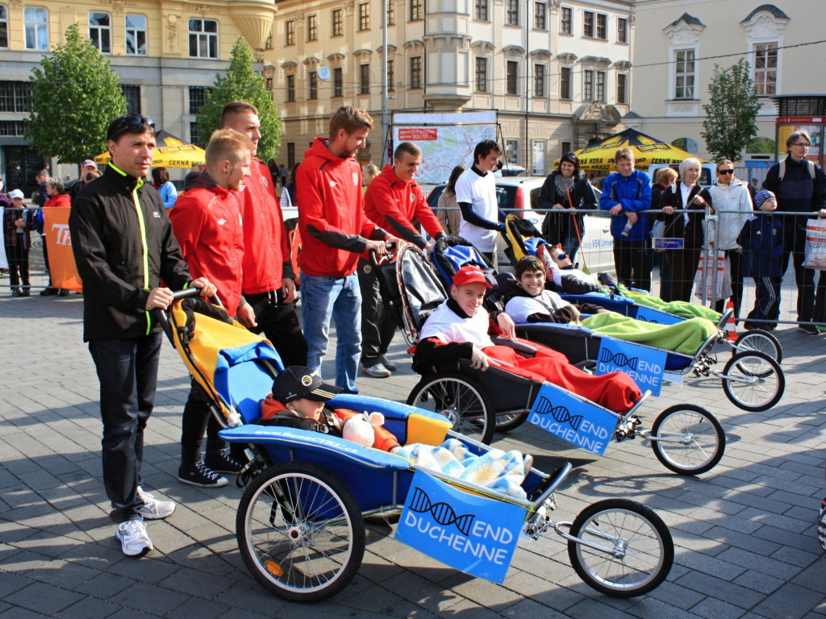
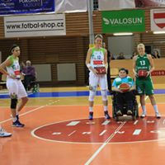
END DUCHENNE
Formal organization
About 20 famillies

Slide 3
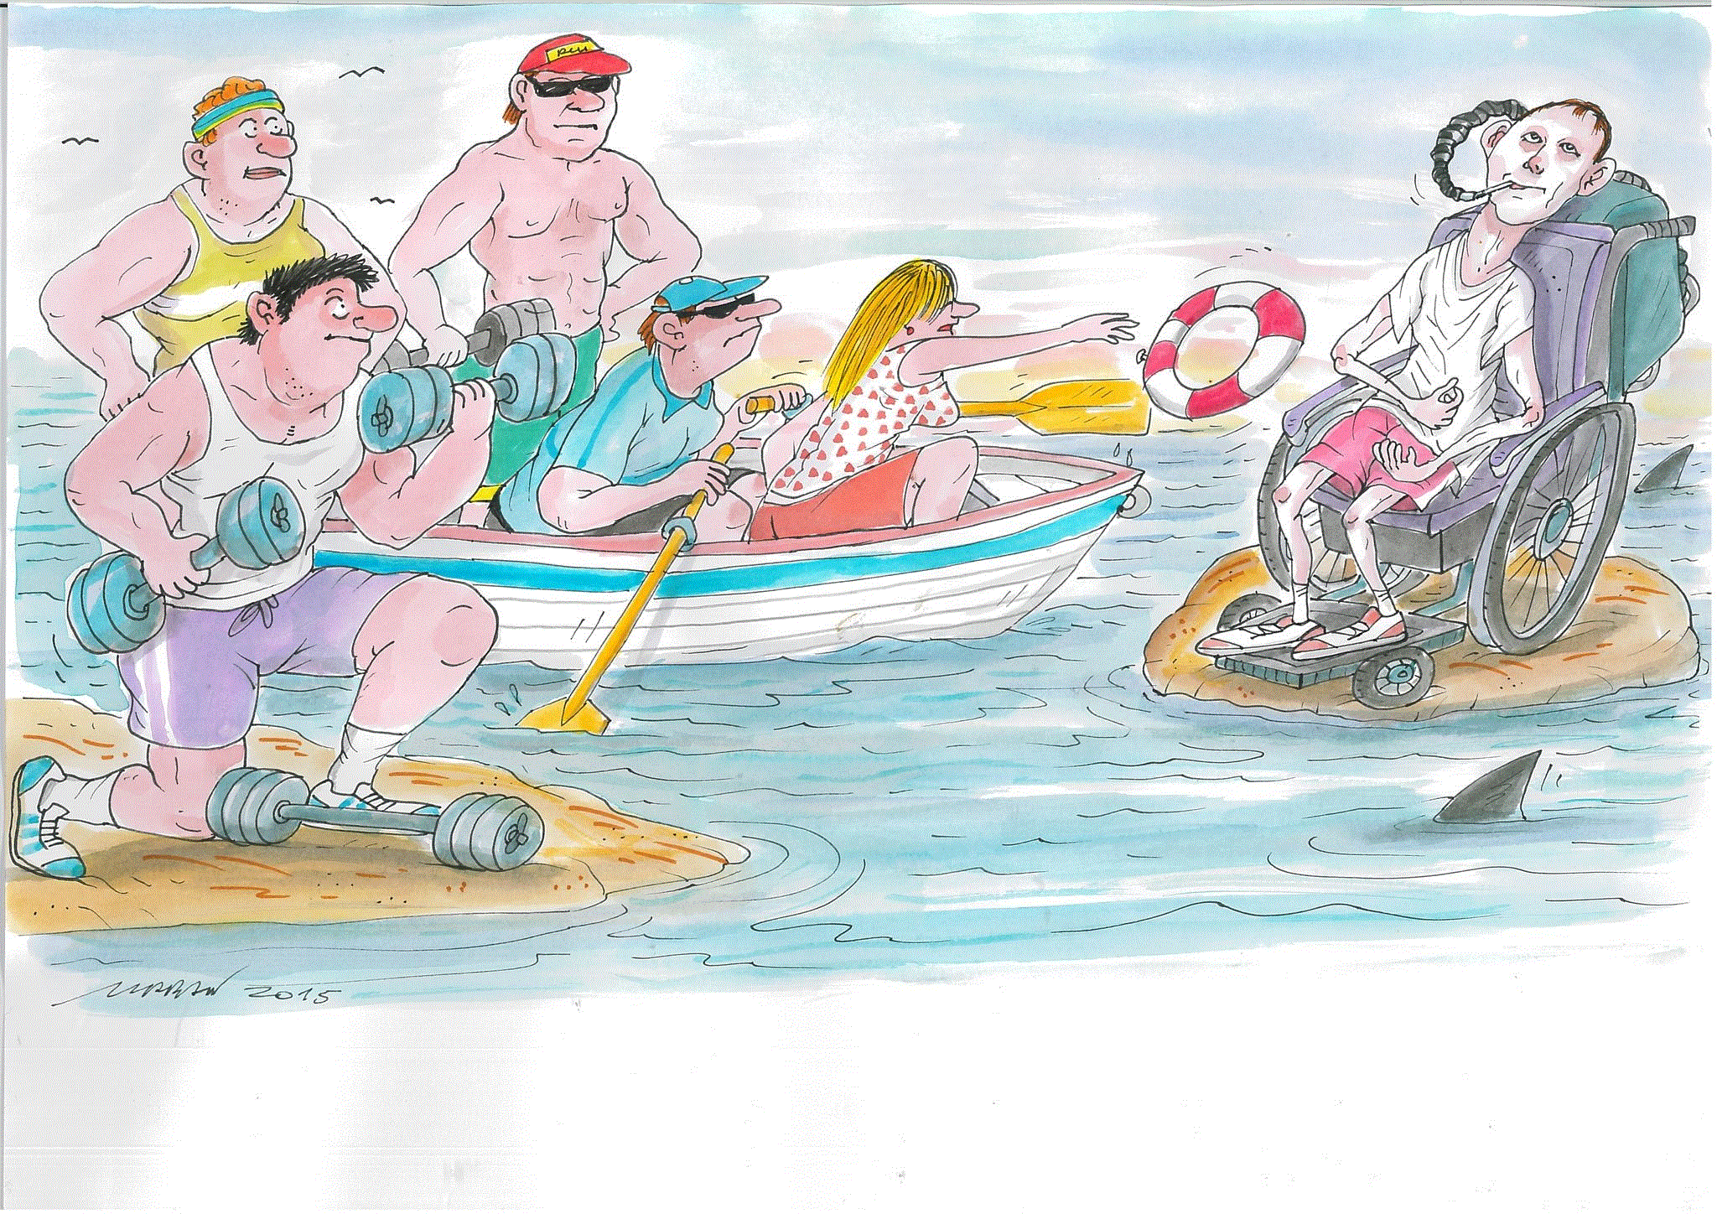
LONG TERM PROJECTS

Slide 4
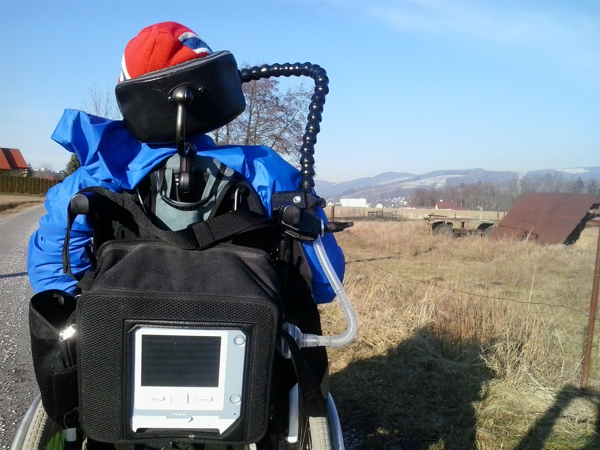
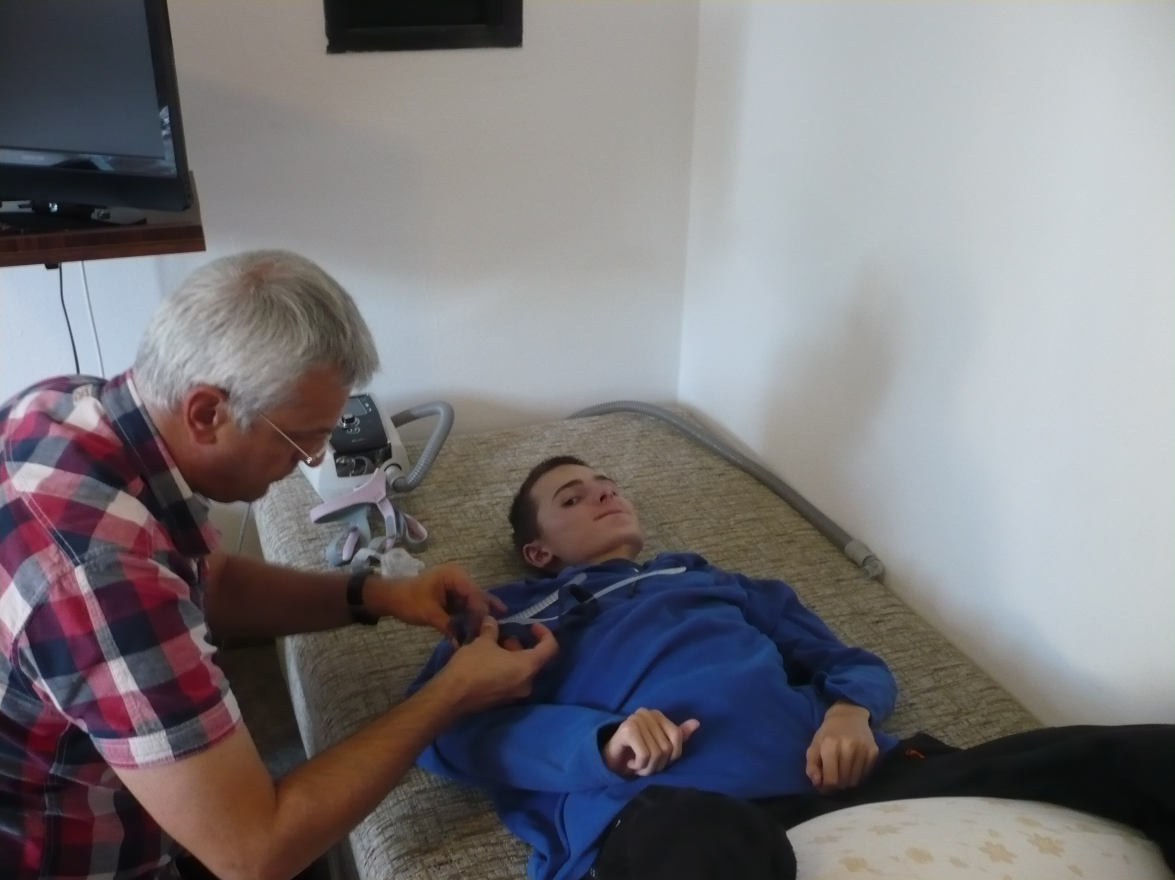
SPECIALIZED CARE
BREATHE INTO NEW LIFE - First DMD patient with mouthpiece ventilation in Czech Republic
Cooperating with Dr. Michel Toussaint from Inkendaal clinic in Belgium
To provide a systematic and preventive ventilation care for all DMD patients
Notes:
The average life expectancy of DMD patients in the Czech Republic is, on average, 10 to 15 years lower than in developed countries, where patients receive comprehensive and systematic care. The main reason for this is the lack of systematic and preventive ventilation care for DMD patients. This care can prolong patients’ lives by 5 to 10 years. Ventilation support in the Czech Republic is limited to sleep laboratories, which provide ventilation support only during the night. According to Care-NMD study, which was conducted in European countries in 2010–2013, only 17.6 % of Czech patients aged over 15 have this ventilation support. An efficient daily preventive ventilation support is not provided at all. We consider it unethical to withhold care for terminally ill patients, which can improve their quality of life and significantly prolong their lives. BREATHE IN NEW LIFE Project aims to create a system of ventilation care for DMD patients and raise awareness of this issue within the Czech Republic. Since 2014, we have cooperated on this project with a leading world expert on ventilation for DMD patients – Dr. Michel Toussaint from Inkendaal clinic in Belgium: http://www.inkendaal.be/. Dr. Toussaint was the first to publish on MPV ventilation in DMD patients.

Slide 5
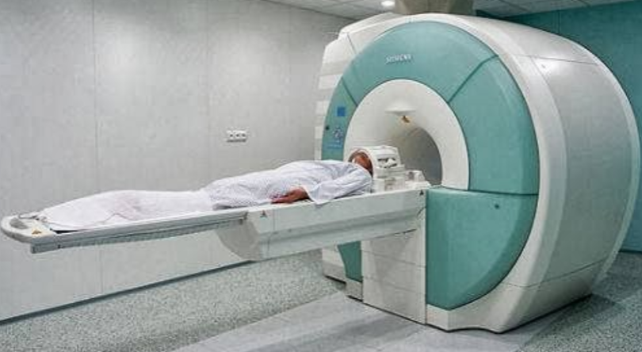
RESEARCH
Collaboration with the University Hospital Brno on a research project on cardiomyopathy progression in DMD patients using MRI

Slide 6
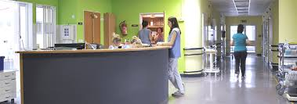
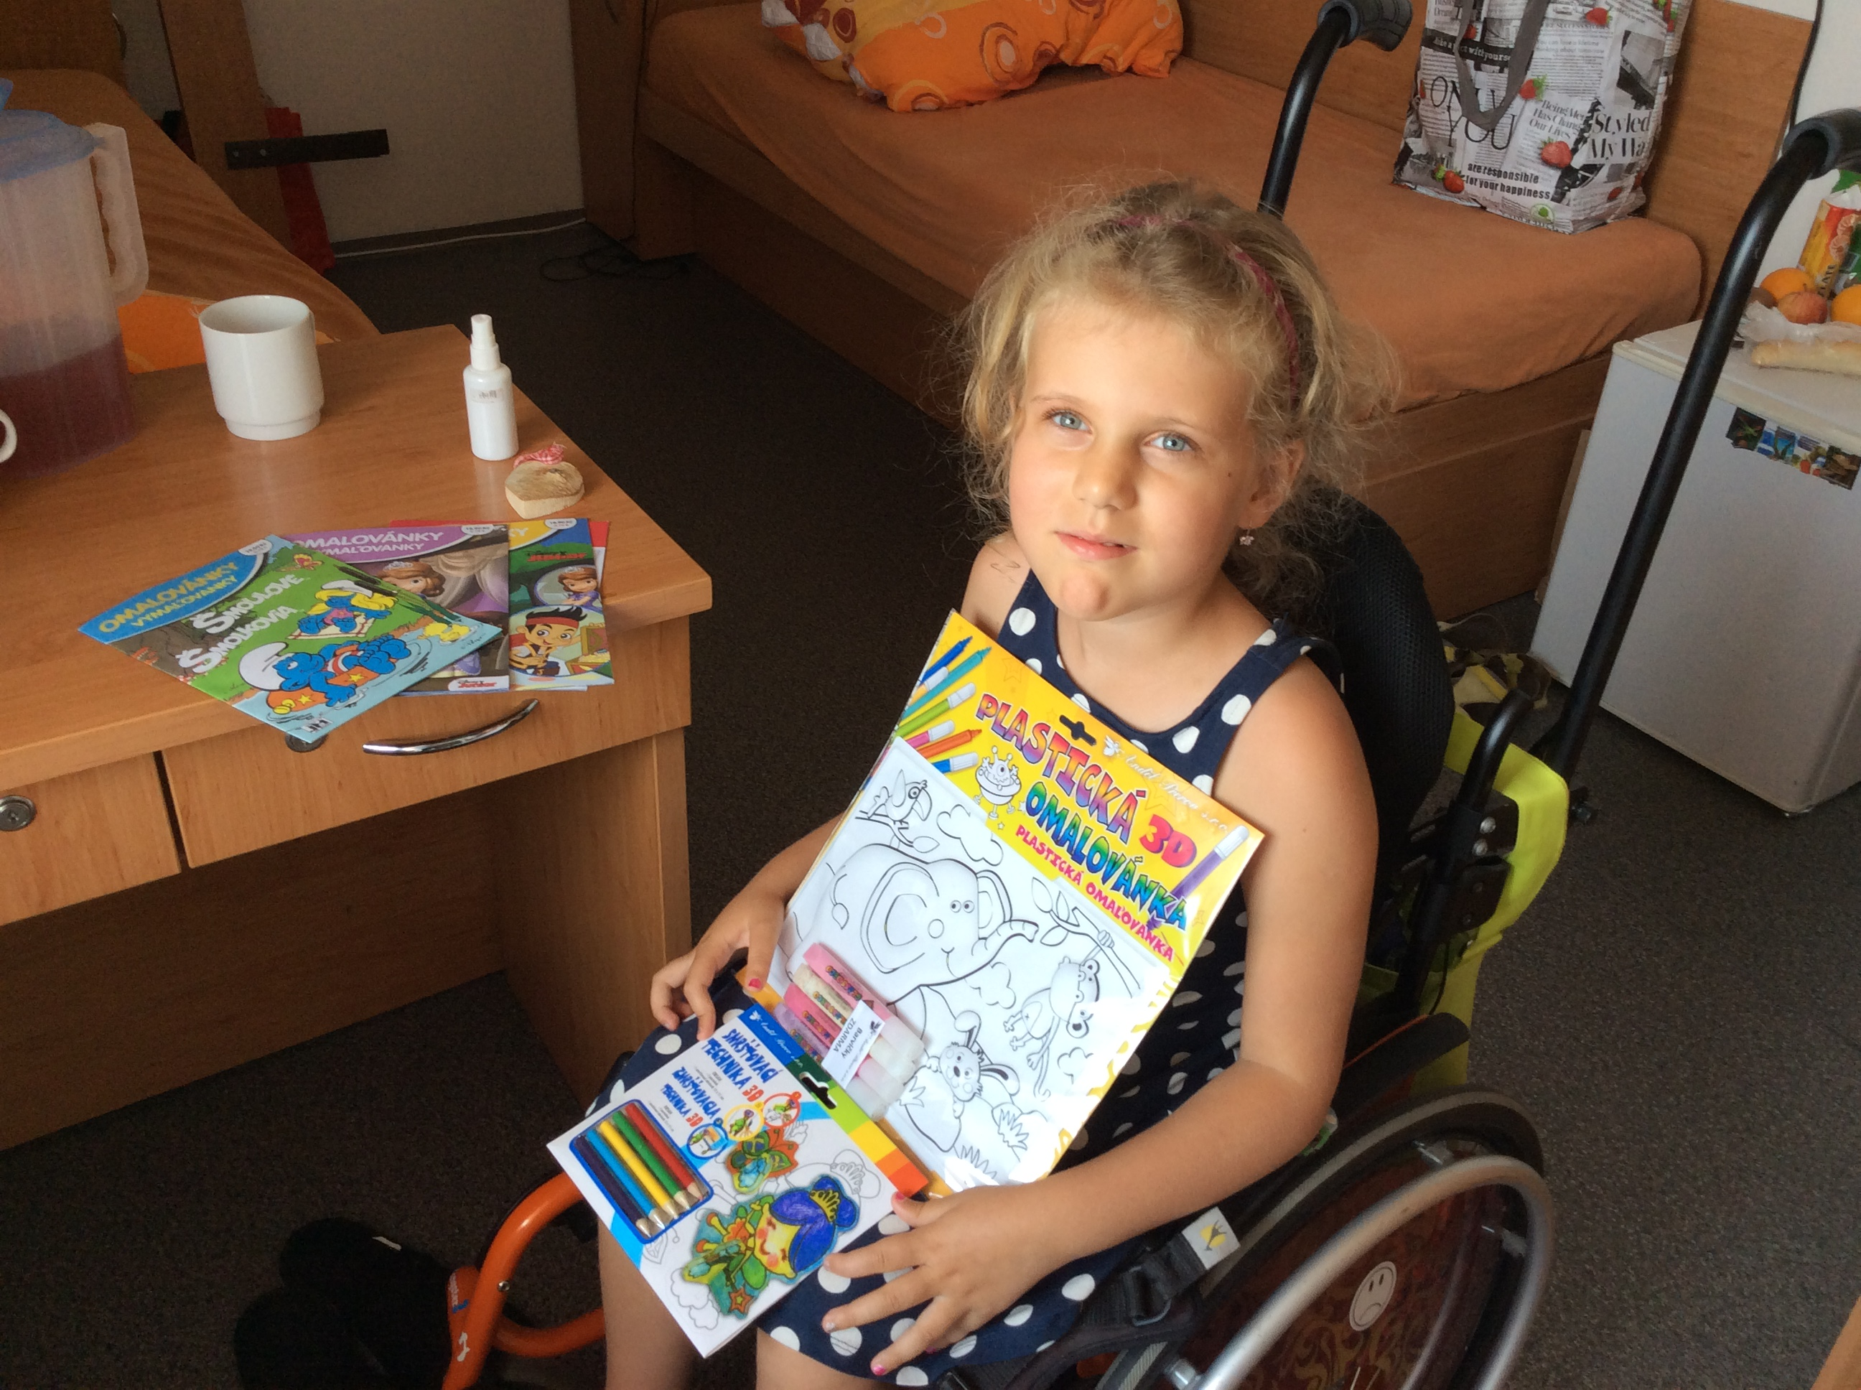
DAYS AT CLINIC
Psycho- social intervention for DMD famillies at Childrens Medical Center FN Brno
To raise number of patients registered in READY Registry http://ready.registry.cz/ which we initiated in 2004 in cooperation with MUDr. Petr Vondraček
Today REaDY is also for patients suffering from SMA, DM and FSHD.

Slide 7
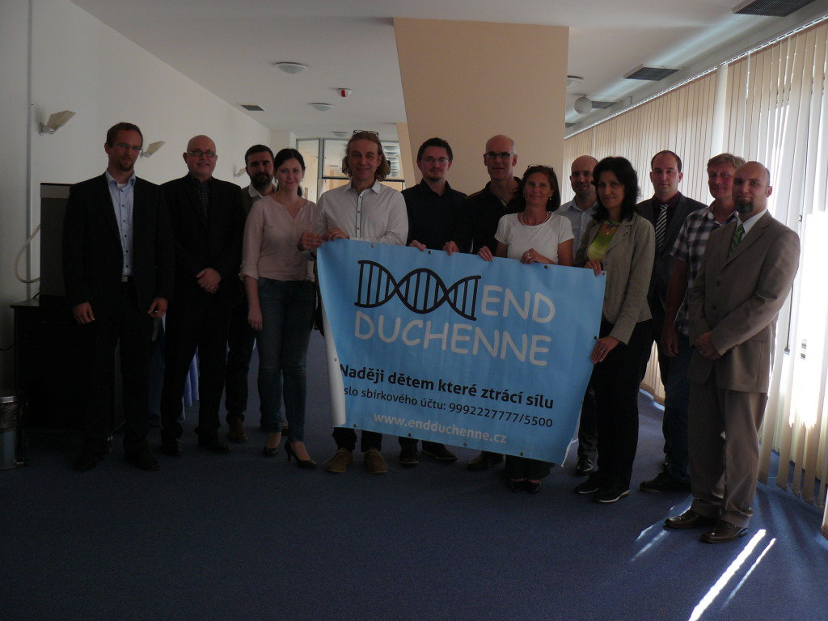
EDUCATION
Workshops and conferences
We cooperate with the Department
of Neurology of the 1st Faculty of
Medicine and General teaching
Hospital in Prague and with
the Clinic of Paediatric
Neurology in Brno

Slide 8
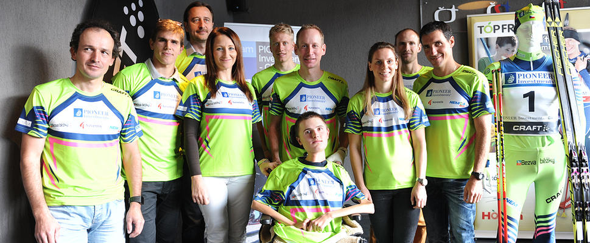
AWARENESS
Ambassador of End Duchenne is an Olympic medallist in cross country skiing - Lukas Bauer and his team PioneerInvestments.

